Slide 1
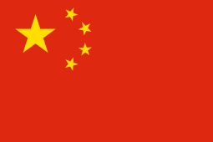
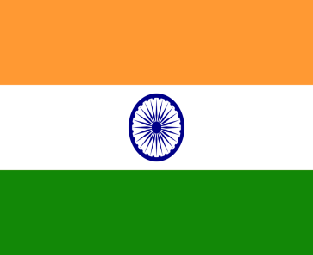
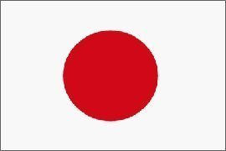
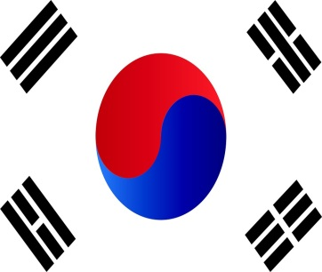
Employee relations in Asian subsidiaries in Hungary: home or host country factors dominate?
M. Sass, É. Ozsvald, K. Shobha and Á. Szunomár
MTA KRTK KTI
(M. Sass: MTA KRTK KTI and BGE)

Slide 2
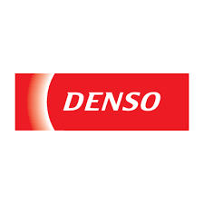

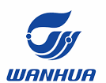

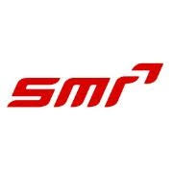



Background of the research
Asian foreign direct investments are substantial in Hungary in regional comparison
  Japan, Korea, China and India play an important role in the Hungarian economy
  even more important than previously thought, according to BPM6 data
Aims:
  to show what characterizes Asian FDI in Hungary
  to analyse how it differs from the overall “FDI landscape”, from subsidiaries coming from non-Asian companies
  to map out factors - home and host country institutions, business and management culture - that influence the operation, HR management of these Asian companies
  Work-in-progress

Slide 3
Theoretical basis
Varieties of Capitalism (VoC) approach – provides an analytical framework:
The role of institutions in „shaping” the variety of capitalism
Previous literature on Asian variaties of capitalism (Carney et al., 2009; Witt and Redding, 2013) – no „Asian variety” found and on DME (Nölke. Vliegenhart, 2009)
Methodology
Company interviews
  conducted with the representatives of five Japanese, Korean, Chinese and Indian-owned subsidiaries in Hungary, in automotive and/or electronics industries
  2 to 10 interviews per company
Macro data: direct versus ultimate investors: more important than previously thought (million euros and %)
 | direct | ultimate | direct in %total | ultimate in % total
China | 214.7 | 1781.9 | 0.3 | 2.3
Hongkong | 412.8 | 127.4 | 0.5 | 0.2
India | 87.3 | 1642.9 | 0.1 | 2.1
Japan | 753.8 | 2065.3 | 1.0 | 2.7
Korea | 1275.8 | 1136.8 | 1.7 | 1.5
Total | 77199.3 | 77199.3 | 3.6 | 8.7

Slide 4
Do home or host countries dominate in shaping subsidiary strategy/management etc.?
Institutionalised characteristics used for the analysed countries and the DME model (Hungary) include industrial relations, employee relations, vocational training, employees’ training, promotion, turnover and skills acquisition of the employees (sources: Nölke and Vliegenhart, 2009; Rugraff, Sass, 2017; Carney et al., 2009; Witt, Redding, 2013)
“Home country VoC” differs from each other to a large extent in case of all the four analysed countries.
Except the similarity in case of low level of workers’ organisation, low union density, in all the other areas, the five countries differ from each other.
Based on the above areas of analysis, questionnaire was compiled and executed through interviews with various officials of the companies (two to ten interviews per company)
Accordingly institutional characteristics of the MNC subsidiaries in Hungary, compared to the features of the DME model, are analysed.

Slide 5
 | China |  | India | Japan | Korea | DME
industrial relations
high or low share of expatriates among the leading managers of the subsidiary | not relevant |  |  |  |  | Mixed, usually low
State intervention in wage bargaining | high state- intervention | low-medium state intervention |  | low state intervention | medium state intervention | company-level, low state intervention
subsidiary-/company-level coordination about working conditions: yes/no | no | yes |  | yes | yes | Yes
works council or trade union at the subsidiary: yes/no (which?) | no (low union density) | no (low union density) |  | no (low union density) | no (low union density) | Usually no (low union density)
employee relations
long-term contracts or short-term contracts | short (private), long (state-owned) | short (private), long (state-owned) |  | long | medium | Long-term
vocational training
vocational training exists at the workplace: yes/no | no | no |  | yes | yes | Yes,
overall education level: high/low | medium | medium |  | high | high | Low-medium for blue-collar workers, medium-high for white-collar
employees
turnover: high or low | medium | medium |  | low | medium | Rather high (blue-collar)
main basis of promotion and pay rises | relationships | relationships and seniority |  | seniority | seniority | Merit, seniority
skill acquisition | private | private, some corporate |  | on the job training | on the job training, private | Private (partly state-financed)
trainings at the firm: frequent or rare | Rare | medium |  | frequent | frequent | Relatively frequent

Slide 6
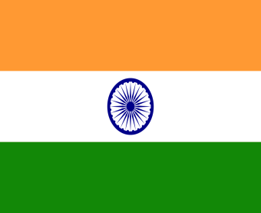
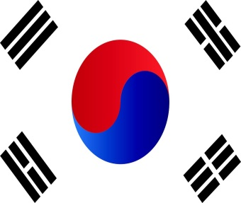
Results
Subsidiaries vis-à-vis DME:
Industrial Relations
High share of expat-managers in case of Chinese and Japanese subsidiaries whereas it is low in case of the other two countries which is similar to DME model
Existence of subsidiary level coordination about the wages and working conditions in all the four cases in similar to DME
Trade unions/Work councils are there in case of Indian and Korean subsidiaries in contrast with DME model
Employee relations:
Mostly long term working contracts in all the subsidiaries, in consistent with DME, except in Chinese subsidiary.
Existence of various social and other services to the employees in all the four country-subsidiaries, like in DME model
Vocational training exists in all the subsidiaries; however the required education levels vary from low to high, unlike DME (medium)
Employees:
Turnover is high, like in case of DME, in all the subsidiaries except those of India
Skill levels are industry-specific, similar to DME model, in the case of Chinese and Korean subsidiaries and general and firm-specific in the case of others
Trainings are frequently provided in almost all the subsidiaries, which is the similar concept in case of DME
Results reveal that in the majority of areas, host country characteristics were shaping the local outcomes to a great extent, while in certain areas, the home country impact dominates.

Slide 7
Results
Subsidiaries vis-à-vis DME:
We could find certain cases, where home country practices, very different from local ones, were kept for a long period of time
Special home country practices kept in Hungary, for example:
Chinese: informal manager pairs per area (one local, one Chinese)
Indian: „Vastu” religion impact; signs and posters with general instructions
Japanese: working in paris pon the shop floor; open office of managers; quotations from the Japanese CEO
Korean: very clean environment, management in Quasi-open office

Slide 8
Preliminary conclusions
Asian FDI much more significant in Hungary than previously thought
Management and labour relations in these companies evolve under influences and through the interaction of related home and host country culture – contains elements of both
In the majority of areas, host country factors dominate, in a few areas home country ones
Because of differences of Asian VoCs (both from others and from each other) – these subsidiaries operate in Hungary in a special way
Further research: what determines, if home or host country factors dominate (we hypothesize: host country economic, political, institutional and other conditions plus home country approach to the (level of autonomy) of the foreign subsidiaries)?

Slide 9
Thank you for your attention!

